Slide 1


SmartEXEC Mine Ventilation On Demand System at the Xstrata Nickel Rim South Mine, Sudbury, Ontario;
Implementation and Results to Date
Authors:
Hugo Dello Sbarba, Simsmart Technologies, Montreal QC, Canada
Erik Bartsch Xstrata Nickel, Sudbury, Ontario, Canada
Josh Lilley, Hatch, Sudbury, Ontario, Canada

Slide 2
Introduction
U/G ventilation provides fresh air to workers, dilutes diesel equipment gases/ particulate matters, and evacuates dust and noxious gases.
In Ontario U/G ventilation requirements determined by legislation (100cfm/hp)
Ventilation systems are typically set to meet the requirement at peak production and operating conditions.
During periods of reduced operations, this results in ‘waste’

Slide 3
Introduction
Ventilation on Demand (VOD) is the adjustment of ventilation equipment settings according to vehicle and personnel current status and location
VOD reduces the ‘waste’ by matching the ventilation to what is actually required in various parts of the mine.

Slide 4
VOD Implementation
Auxiliary (secondary) ventilation control
  Start and stop of an auxiliary fan:
    on a fixed schedule
    as vehicles or personnel enters heading
  Adjustment of auxiliary fan Variable Frequency Drive (VFD)
    To meet the required vehicles airflow demand within a given zone or
    To maintain adequate level of gases or temperature.
  Adjustable of dampers for multi-openings duct network
    To meet vehicles’ airflow demand at a given position
    To maintain adequate level of gases or temperature

Slide 5
VOD Implementation
Primary ventilation control
  Adjustment of regulator and/or booster fans settings
    To meet vehicles’ airflow demands within different primary ventilation zones
    To maintain adequate level of gases or temperature
  Optimization of regulators, booster fans and primary fans settings to minimize energy consumption of the system while satisfying all airflow demands within the primary zones.

Slide 6
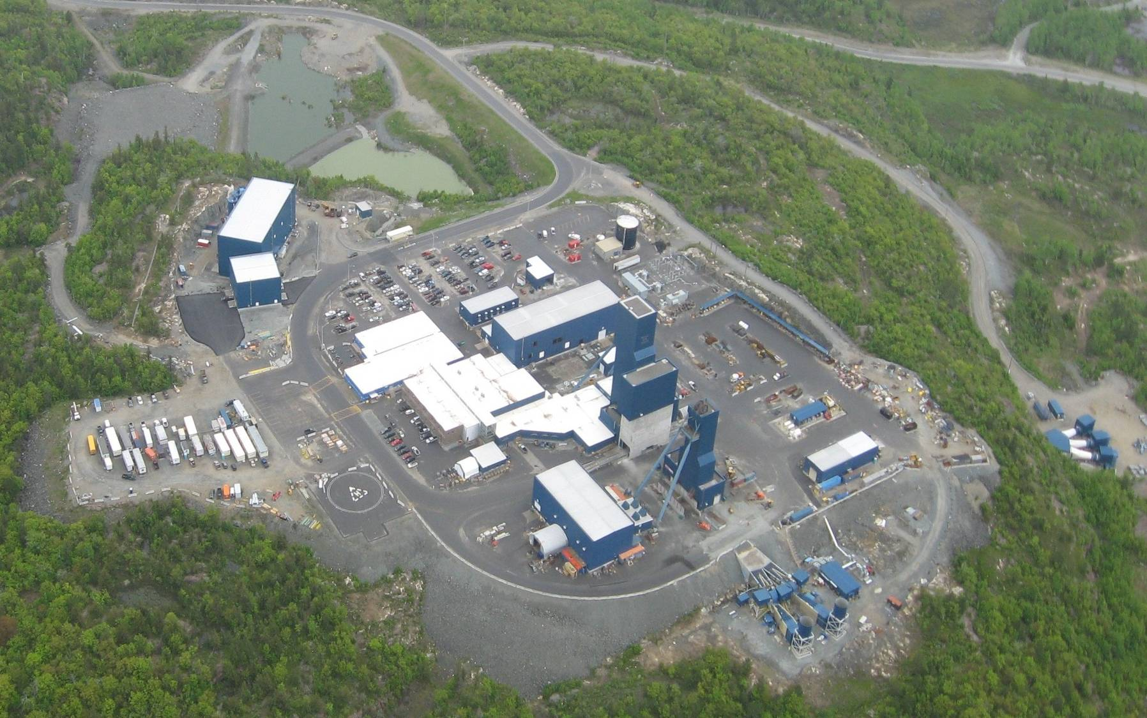
Nickel Rim South (NRS)
Backfill Plant
Compressor House
Main shaft (3 Hoists)
Intake fans
Admin -
Workshops
Vent Shaft & Hoist
Exhaust fans

Slide 7
VOD Requirements
Remote control ventilation equipment
  Instrumentation (flow and gas sensors)
  Automated flow regulators
  Remote control of Starters and VFDS
Automation and Communication system
  Ventilation equipment ↔ PLC ↔ Ethernet
  Ventilation equipment ↔ Remote I/O ↔ Ethernet
  Ventilation equipment ↔ Leaky feeder remote I/O ↔ Leaky feeder ↔ Leaky feeder remote I/O concentrator
  Ventilation equipment ↔ PLC ↔ Leaky feeders remote I/Os ↔ Leaky feeder ↔ Leaky feeder remote I/O concentrator
Tagging and Tracking system
VOD execution software: SmartEXEC

Slide 8
NRS VOD Objectives and
Economic Justification
Optimize usage of fresh air supply while supporting level of activity required to achieve planned production rates.
    Non production zones.
    Machinery Diesel “off” during shift.
    Maintenance or holiday periods as non operating time
    Blast clearing times- evacuate blast gases optimally
    Reduce power consumption
    Reduce natural gas consumption
Independent evaluations resulted in identified potential savings of between 34% and 48%

Slide 9
NRS VOD Implementation
Stage 1: Remote/Manual Ventilation Control
    Manual control and event scheduling: intelligent HMI for surface/remote control (fans on-off or VFD speed set point, controllable doors, regulators/dampers)
Stage 2: Flow or gas control mode
    Control based on the gas concentration from sensors as well as airflow sensors (PID control loop)
Stage 3: Dynamic VOD
    Flow control via ventilation demand calculation: as a function of personnel location and machinery location & operating status (zone in/out gates coverage to full tracking coverage)
    Optimization control: air flow distribution and surface fans energy

Slide 10
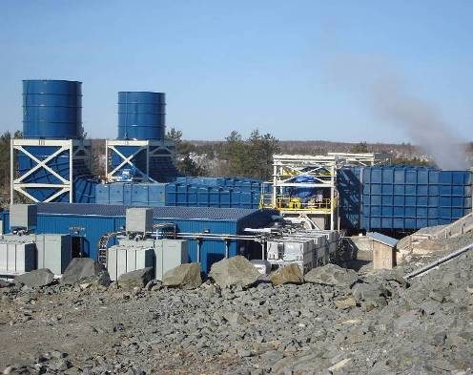
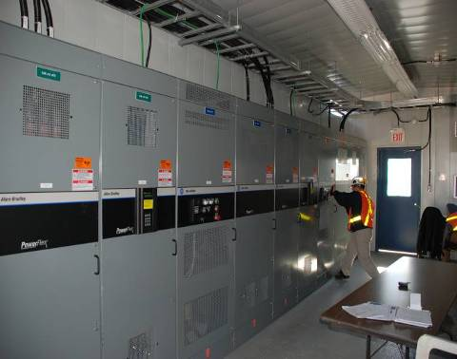
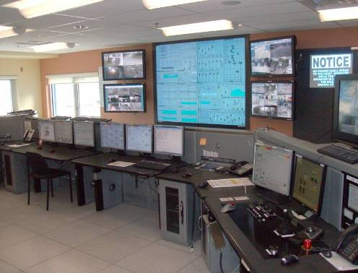
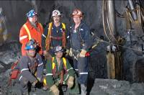
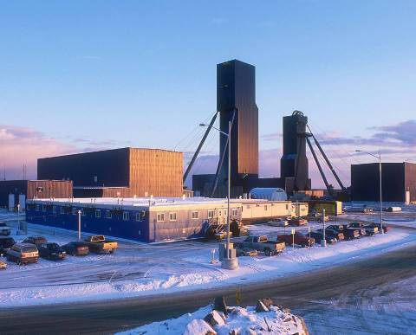
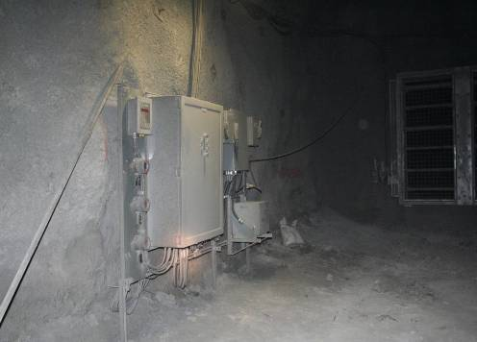
Project Timeline
2008 Q4 | VOD Scoping study completed
2009 Q1 | VOD Vendor review & selection.
Q2 | First automated underground regulator and air-monitoring station installed.
Q3 | All surface fan automation complete
Q4 | First underground aux fan controls commissioned
2010 Q1 | Stage 1 Complete (Remote Manual control)
Q2 | Simsmart VOD software installed
Q4 | Stage 2 Complete (Scheduled event based control). Tracking System VOD integration complete. Real-time air demand calculated.
2011 Q1 | Perform first Stage 3 operation (Dynamic VOD : Mobile equipment air-flow control)
Q2 | Surface main Fan dynamic speed optimization implemented
Q3-4 | Increase utilization of stage 2 and prepare for stage 3 operation.

Slide 11
NRS Ventilation Flow
U/G Ventilation
System operated/monitored
from Surface OC
Air Flow
System Control
Main Shaft
Headframe
12 m³/s Up-cast
Exhaust Fans
Vent Shaft
Main Shaft
Supply Fans
1280L
570m³/s
Capacity (-6.5kPa)
1480L
1520L
540m³/s shaft capacity
(12m/s)
1660L
1700L

Slide 12
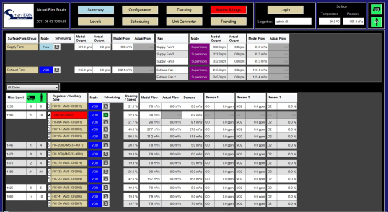
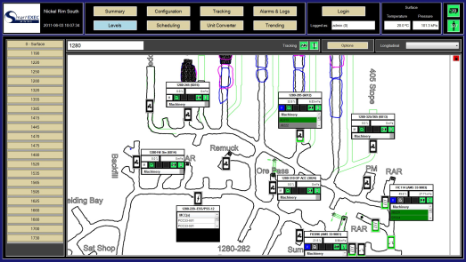

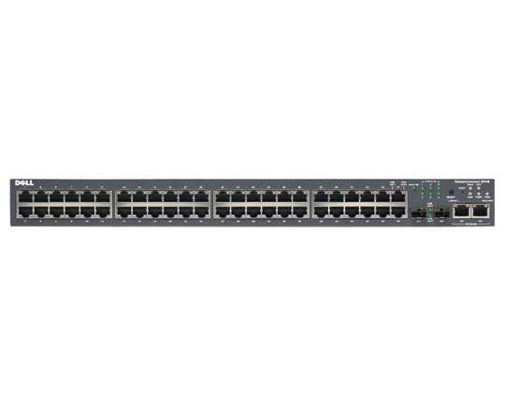
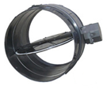
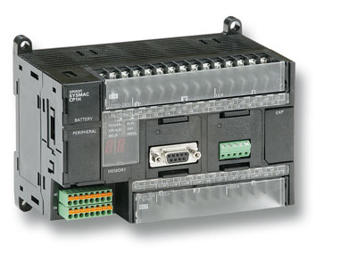
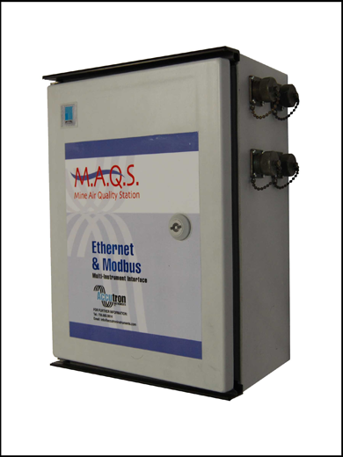
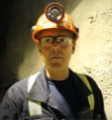
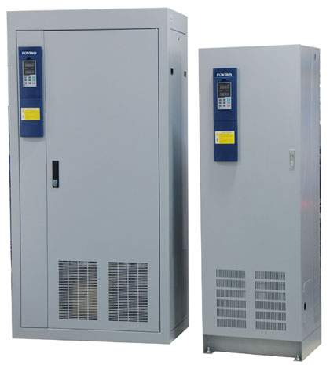
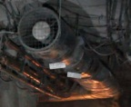
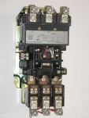
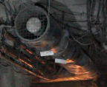

User
interfaces
Dynamic tracking system server
Dynamic
Tracking
system
Server
SQL db
Surface Ethernet
switch
Surface and underground
Measurement and control
infrastructure
Switch Ethernet on each level
Dampers and regulators
Underground Wifi access
PLCs
VMS
Gas and flow
measurements
OPC communication
to PLCs
Personnel RF ID
detection
VFD
Machinery RF ID
detection and
operating status
reporting
Starters
Wifi
Access
point
Wifi
Access
point
…
Wifi
Access
point

Slide 13

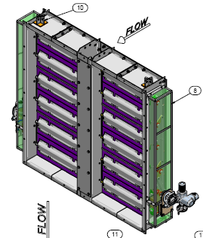
Air Monitoring Stations at RADs
Flextor Regulator
PLC Panel
Accutron Flow
Transmitter
Pressure
Transmitter
Carbon Monoxide
Sensor
Oxygen
Sensor
Actuators
Nitrogen Dioxide
Sensor
Communicate back to nearest Automation Control Centre (ACC)
Primarily controlled from surface but autonomous operation possible if communication is lost.

Slide 14
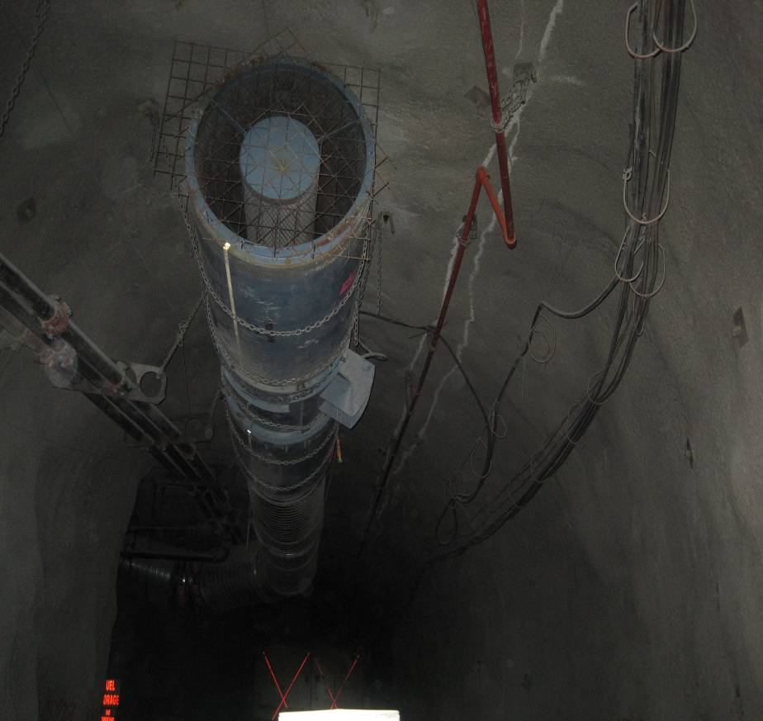
Auxiliary Fans
‘Intelligent’ portable sub-stations designed for 3 fan sizes (100hp,50hp, 30hp)
Remote monitoring and Start/Stop capability.
‘Plug-in’ or permanently wired.
Controlled by local Automation Control Centre (ACC).
Can operate independently if communication with surface is lost.

Slide 15
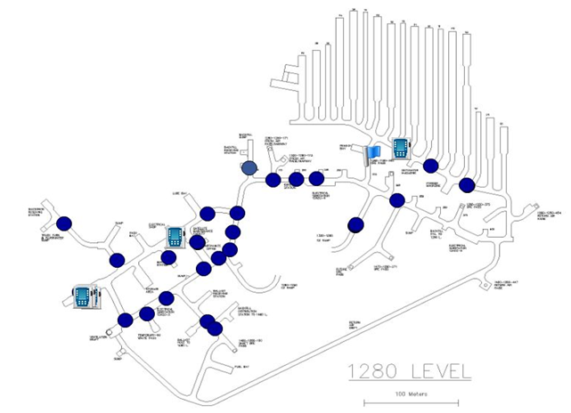
Tagging and Tracking System
Using existing wireless infrastructure
No additional infrastructure (e.g. positioning beacons) required.
Real time locating service (RTLS) uses Received Signal Strength Indication (RSSI) to indicate position (see right)
Hardware or ‘soft’ tags

Slide 16
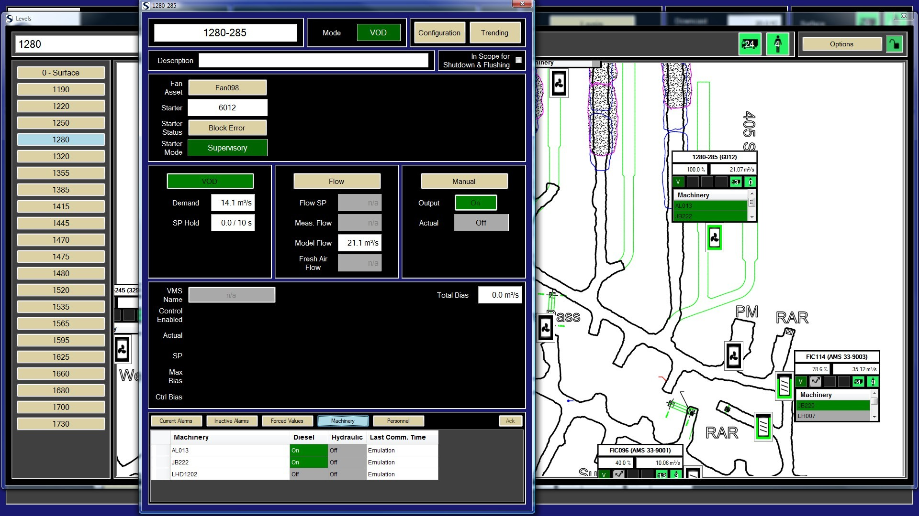
SmartEXEC HMI

Slide 17
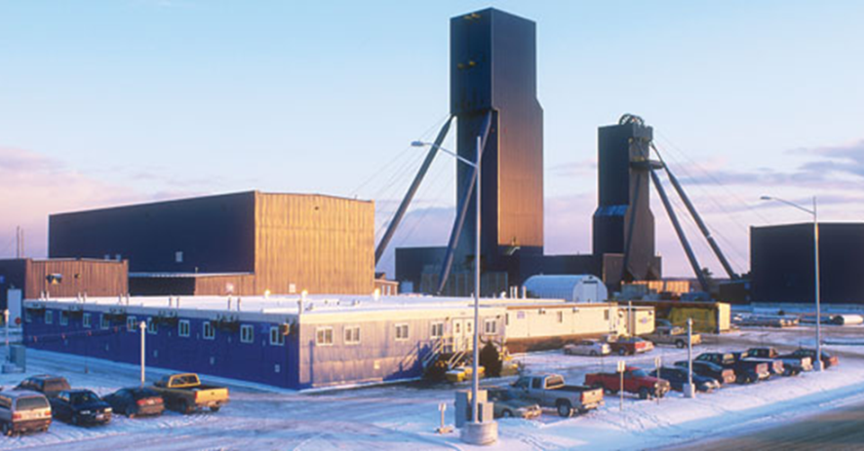
Implemented Ventilation Control
Control of 2 x 4000 hp and 3 x 550 hp surface fans
Control of 119 auxiliary fans
Control of 17 air flow regulators on Return Air Drifts
Air flow regulators control air as a function of the air demand on each related mine level
Air distribution optimization on 13 levels
Energy (speed) optimization for surface fans
Flow control per level
Events and schedule control for all fans and regulators
Link to mine wide tagging and tracking system

Slide 18
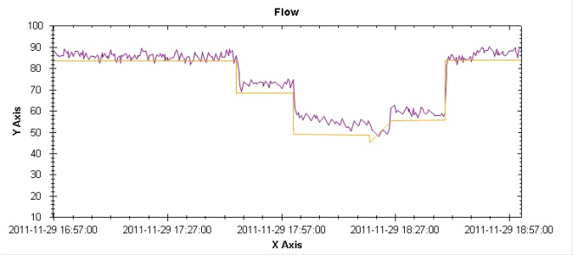
Implemented Ventilation Control
Model Flow Control results
  Main surface fans speed reduction
  Change in regulator position
  Main surface fans speed increase
  Regulator position set back to its initial setting
Regulator FIC123 Nickel Rim South mine, Model flow (orange) vs. measured flow (purple)

Slide 19
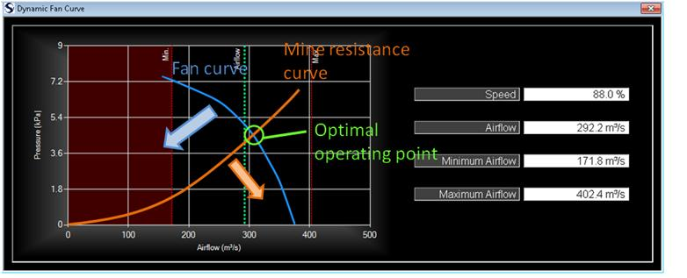
Implemented Ventilation Control
Control strategy
  Always maintain one of the regulator at minimal resistance (80% opening)
  Control the surface fans from the settings of the regulator at the minimal resistance
    Opening < 80% surface fans speed will decrease
    Opening > 80% surface fans speed will increase

Slide 20
Energy Savings
VOD Power Shed: Scheduling
Total MWh
638
501
558
549
575
473
697
876
Current annual projection: 10,140 MWh of annual savings.
Expected to exceed this as further aux fans included under VOD control

Slide 21
Achievements
Implementing a full mine-wide control strategy controlling 17 regulators and 5 main surface fans to achieve optimal main fans operating point
Performing VOD control (starting and stopping fans from vehicles’ presence) in several auxiliary zones
Having remote control of more than 120 auxiliary fans
Performing daily event schedule during shift change on the 120 auxiliary fans and the 5 surface fans
Minimizing blast clearing times by creating scheduled events

Slide 22
Acknowledgements
Xstrata nickel
Hatch
Questions?

